Slide 1
R Programming

Slide 2
R
The program 'R' is currently not installed. You can install it by typing:
sudo apt-get install r-base-core
ubuntu@ip-172-31-26-143:~$ sudo apt-get install r-base-core

Slide 3
Basic Data Types of R
Decimal Values are numerics in R. It is the default computational data type. If we assign a decimal value to a variable i or f as follows , they will be of numeric type:
> i = 1
> class(i)
[1] "numeric"
> f = 1.23
> class(f)
[1] "numeric"
>

Slide 4
Storing an integer into a value does not make it an integer
> i = 1
> class(i)
[1] "numeric"
> is.integer(i)
[1] FALSE
In order to create an integer variable in R, we invoke the as.integer function
> i = as.integer(5)
> class(i)
[1] "integer"
> i = as.integer("5.25")
> class(i)
[1] "integer"

Slide 5
A complex number in R is defined through use of the pure imaginary value i
> z = 1 + 2i
> z
[1] 1+2i
> class(z)
[1] "complex"
> sqrt(-1)
[1] NaN
Warning message:
In sqrt(-1) : NaNs produced
> sqrt(-1+0i)
[1] 0+1i
> sqrt(as.complex(-1))
[1] 0+1i
>

Slide 6
Logical values
> x = 1; y = 2
> z = x > y
> z
[1] FALSE
> class(z)
[1] "logical"
> u = TRUE; v = FALSE;
> u & v
[1] FALSE
> u | v
[1] TRUE
> !u
[1] FALSE
>

Slide 7
Character data type
> x = as.character(3.14)
> x
[1] "3.14"
> class(x)
[1] "character"
> fname= "joe"; lname= "smith"
> paste(fname,lname)
[1] "joe smith"
>

Slide 8
A vector is a sequence of data elements of the same basic data types
[1] "joe smith"
> l <- c(2,3,4)
> l
[1] 2 3 4
> logicals <- c(TRUE, FALSE, FALSE)
> logicals
[1] TRUE FALSE FALSE
>

Slide 9
> f <- data.frame(a = c(1,2), b = c(4,5), c = c(8,6))
> f
a b c
1 1 4 8
2 2 5 6
> f[0,1]
numeric(0)
> f[,1]
[1] 1 2
> f[1,]
a b c
1 1 4 8
> f[1:1]
a
1 1
2 2

Slide 10
> demand <- c (1,5,2,4)
> building <- c("build1","build2","build3","build4")
> supplyChain <- data.frame(demand=demand, building=building)
> supplyChain
demand building
1 1 build1
2 5 build2
3 2 build3
4 4 build4
> supplyChain$demand
[1] 1 5 2 4
> supplyChain$building
[1] build1 build2 build3 build4
Levels: build1 build2 build3 build4
> supplyChain[,1]
[1] 1 5 2 4
> supplyChain[,2]
[1] build1 build2 build3 build4
Levels: build1 build2 build3 build4
>

Slide 11
You can index rows in a table with a “Hash” style representation
> row.names(supplyChain)[1] = "Jan"
> row.names(supplyChain)[2] = "Feb"
> row.names(supplyChain)[3] = "Mar"
> row.names(supplyChain)[4] = "Apr"
> row.names(supplyChain)
[1] "Jan" "Feb" "Mar" "Apr"
> supplyChain
newDemand building
Jan 1 build1
Feb 5 build2
Mar 2 build3
Apr 4 build4
>

Slide 12
> supplyChain
newDemand building
Jan 1 build1
Feb 5 build2
Mar 2 build3
Apr 4 build4
>

Slide 13
> supplyChain[1,]
newDemand building
Jan 1 build1
> supplyChain["Jan",]
newDemand building
Jan 1 build1
> supplyChain$newDemand
[1] 1 5 2 4
> supplyChain$building
[1] build1 build2 build3 build4
Levels: build1 build2 build3 build4
> supplyChain[1,]
newDemand building
Jan 1 build1
> supplyChain[,1]
[1] 1 5 2 4

Slide 14
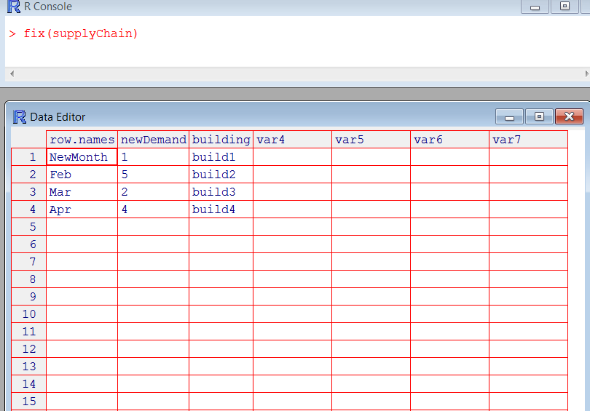
Fix command

Slide 15
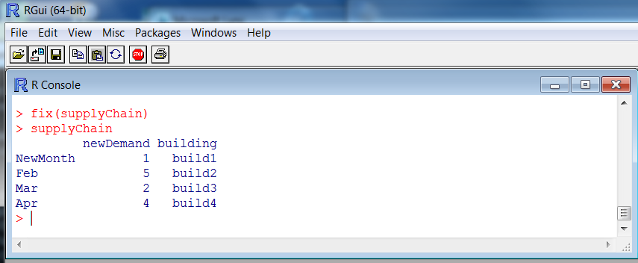

Slide 16
Building a frame with more columns
> table<- data.frame("var" = seq(0,0,length=100))
> dates = c("Jan","Feb","March","Apr","May","June")
> for (var in dates){
+ col = data.frame("var" = seq(0,0,length=100))
+ table<-cbind(table,col)
+ }
> table
var var var var var var var
1 0 0 0 0 0 0 0
2 0 0 0 0 0 0 0
3 0 0 0 0 0 0 0
4 0 0 0 0 0 0 0
5 0 0 0 0 0 0 0

Slide 17
> list <- c()
> for (item in dates){
+ list<- c(list, c(paste(item,"A")))
+ }
> list
[1] "Jan A" "Feb A" "March A" "Apr A" "May A" "June A"
> for (item in list){
+ }
> cnt <- 0
> for (item in list){
+ cnt <- cnt + 1
+ names(table)[cnt] = item
+ }

Slide 18
> table[1:5,]
Jan A Feb A March A Apr A May A June A var
1 0 0 0 0 0 0 0
2 0 0 0 0 0 0 0
3 0 0 0 0 0 0 0
4 0 0 0 0 0 0 0
5 0 0 0 0 0 0 0
>

Slide 19
> cnt <- 0
> for (var in c("demand", "safestock")){
+ cnt <- cnt + 1
+ row.names(table)[cnt] <- var
+ }
> table
Jan A Feb A March A Apr A May A June A var
demand 0 0 0 0 0 0 0
safestock 0 0 0 0 0 0 0
3 0 0 0 0 0 0 0
4 0 0 0 0 0 0 0

Slide 20
Bringing in a file
1,2,3,4
10,20,30,40
15,25,35,45
> f <- read.csv(file("C:\\Users\\dostrows\\My Documents\\daveo\\2015_Hadoop\\EmpTrainingSeminars\\Session2\\test.csv"), head=FALSE)
> f
V1 V2 V3 V4
1 1 2 3 4
2 10 20 30 40
3 15 25 35 45
>

Slide 21
> x <- c(1,2,3,4,5,6,7)
> x <- c(1:7)
> x
[1] 1 2 3 4 5 6 7
> x <- 1:4
> x
[1] 1 2 3 4
>

Slide 22
Create a matrix
> m <- matrix(0,2,2)
> m
[,1] [,2]
[1,] 0 0
[2,] 0 0
> m[1,1] = 1
> m
[,1] [,2]
[1,] 1 0
[2,] 0 0
>

Slide 23
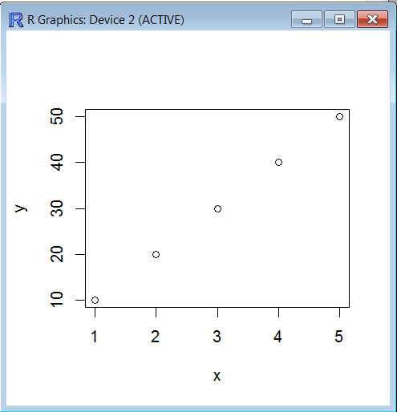
x<- c(1,2,3,4,5)
y<- c(10,20,30,40,50)
plot(x,y)

Slide 24
> list <- c(1,2,3,4,5)
> min(list)
[1] 1
> max(list)
[1] 5
> sd(list)
[1] 1.581139
> mean(list)
[1] 3
> list2 <- c(2.3,4.4,5,7,8)
> cor(list,list2)
[1] 0.9881724
>

Slide 25
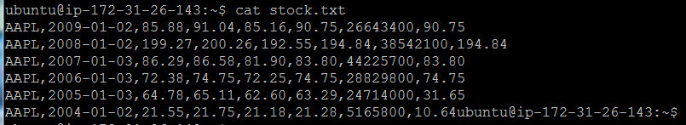
R programming streaming map reduce stock.txt

Slide 26
Mapper (no reducer)
ubuntu@ip-172-31-26-143:~$ cat stock_day_avg2.R
#!/usr/bin/Rscript
options(warn=-1) #2
input <- file("stdin", "r") #4
while(length(currentLine <-readLines(input, n=1, warn=FALSE)) > 0) {
fields <- unlist(strsplit(currentLine, ",")) #6
lowHigh <- c(as.double(fields[3]), as.double(fields[6]))
mean <- mean(lowHigh)
cat(fields[1], fields[2], mean, "\n", sep="\t")
}
close(input)

Slide 27
R script
ubuntu@ip-172-31-26-143:~$ hadoop-1.2.1/bin/hadoop jar /home/ubuntu/hadoop-1.2.1/contrib/streaming/hadoop-*streaming*.jar -D mapreduce.job.reduces=0 -input /home/ubuntu/stock.txt -output output22 -mapper /home/ubuntu/stock_day_avg2.R -file /home/ubuntu/stock_day_avg2.R

Slide 29
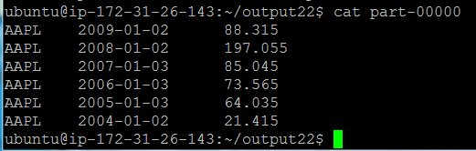
(85.88 + 90.75) / 2. no zero position third and sixth column

Slide 30
ubuntu@ip-172-31-26-143:~/output19$ cat part-00000
AAPL 2009-01-02 88.315
AAPL 2008-01-02 197.055
AAPL 2007-01-03 85.045
AAPL 2006-01-03 73.565
AAPL 2005-01-03 64.035
AAPL 2004-01-02 21.415

